Slide 1
5 Number Summaries
To find the median of a data set:
Step 1: Order the numbers from smallest to largest. Step 2: Find the middle number.
Find the median, lower quartile and upper quartile of the following data set:
13, 15, 13, 11, 16, 13, 12, 15
11, 12, 13, 13, 13, 15, 15, 16
To find the lower quartile of a data set:
Step 1: Underline the bottom half of the data set. Step 2: Find the middle number.
To find the upper quartile of a data set:
Step 1: Underline the top half of the data set. Step 2: Find the middle number.
Median = 13
If the median is one of the values, don’t include it in the lower/upper half.
If the median is between two values, include it in the lower/upper half.
Lower quartile = 12.5
Upper quartile = 15

Slide 2
5 Number Summaries
To find the median of a data set:
Step 1: Order the numbers from smallest to largest. Step 2: Find the middle number.
Find the minimum, maximum, median, lower quartile and upper quartile of the following data set:
2, 9, 4, 2, 5, 8, 9, 6, 6, 2, 3, 7, 5
2, 2, 2, 3, 4, 5, 5, 6, 6, 7, 8, 9, 9
To find the lower quartile of a data set:
Step 1: Underline the bottom half of the data set. Step 2: Find the middle number.
To find the upper quartile of a data set:
Step 1: Underline the top half of the data set. Step 2: Find the middle number.
Minimum = 2
If the median is one of the values, don’t include it in the lower/upper half.
If the median is between two values, include it in the lower/upper half.
Maximum = 9
Median = 5
Lower quartile = 2.5
Upper quartile = 7.5

Slide 3
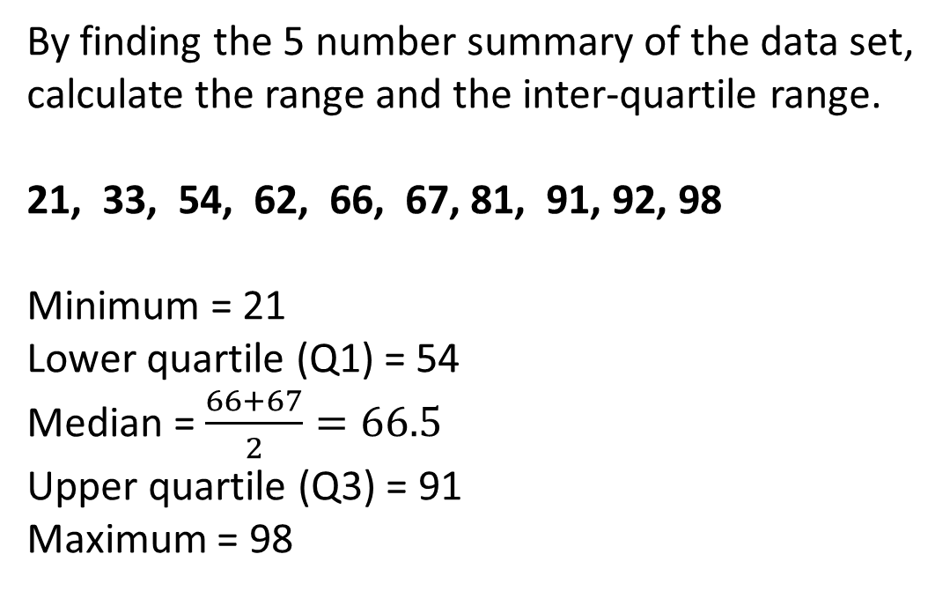
5 Number Summaries
To find the median of a data set:
Step 1: Order the numbers from smallest to largest. Step 2: Find the middle number.
By finding the 5 number summary of the data set, calculate the range and the inter-quartile range.
21, 33, 54, 62, 66, 67, 81, 91, 92, 98
Minimum = 21
Lower quartile (Q1) = 54
Median = $\frac{66+67}{2}=66.5$
Upper quartile (Q3) = 91
Maximum = 98
To find the lower quartile of a data set:
Step 1: Underline the bottom half of the data set. Step 2: Find the middle number.
To find the upper quartile of a data set:
Step 1: Underline the top half of the data set. Step 2: Find the middle number.
These 5 statistics form a 5 number summary of a set of data.
If the median is one of the values, don’t include it in the lower/upper half.
If the median is between two values, include it in the lower/upper half.
Range (maximum – minimum):
98 – 21 = 77
Inter-quartile range (Q3 – Q1):
91 – 54 = 37

Slide 4
Drawing a Boxplot
A box and whisker diagram (or boxplot) is a simple diagram that shows how a set of scores is distributed.
It doesn’t show all the individual scores in a data set, but shows the specific features (the 5 number summary) of the data.

Slide 5
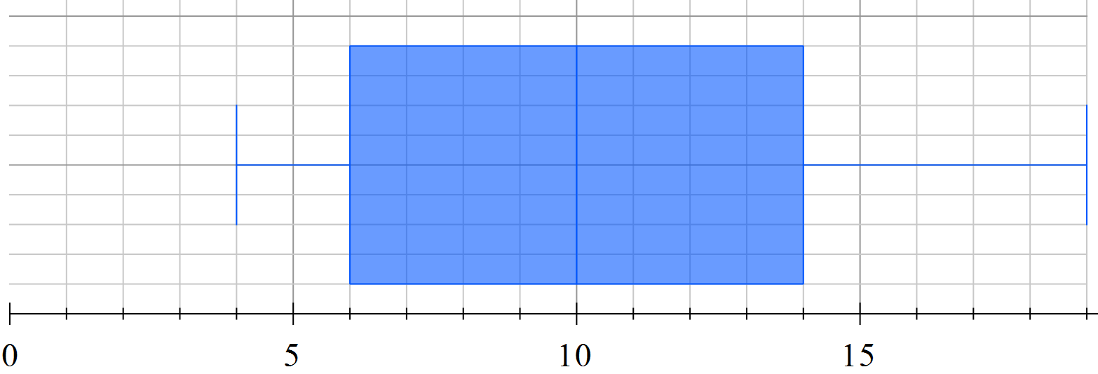
Drawing a Boxplot
Boxplots give a visual overview of the location of the data and how widely spread it is. The range (highest minus lowest) and the interquartile range (upper quartile minus lower quartile) can also be seen.
For example:
12, 6, 10, 19, 9, 12, 4, 14, 8, 16, 6
Listed in order gives:
4 6 6 8 9 10 12 12 14 16 19
Lower quartile (Q1)
Median
(Q2)
Upper quartile
(Q3)
Inter-quartile range

Slide 6
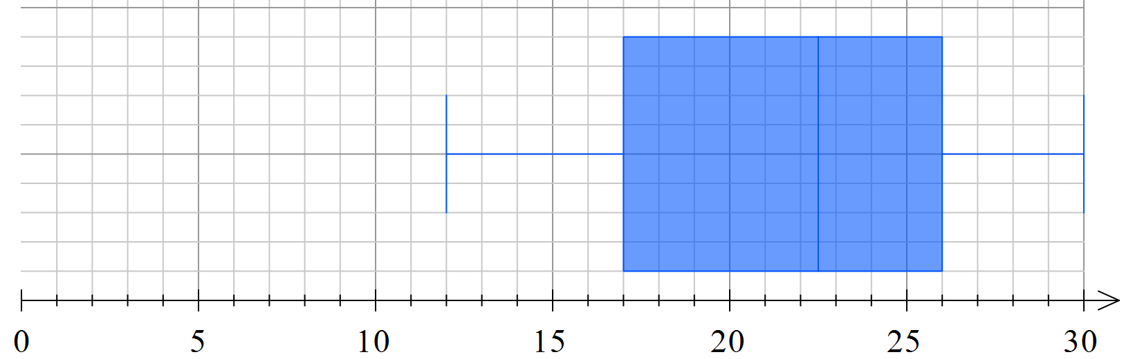
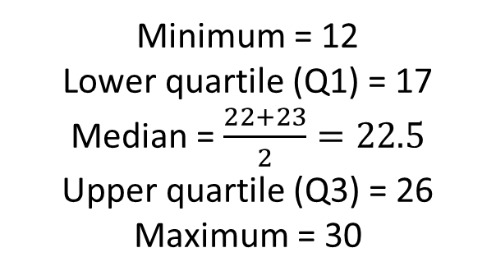
Drawing Boxplots
Draw box and whisker plots for the set of scores.
12 22 22 23 27 14 27 23 21 30 26 17 23 17
Step 1: Order the scores.
Step 2: Find the 5 number summary.
Step 3: Draw the boxplot.
12 14 17 17 21 22 22 23 23 23 26 27 27 30
Minimum = 12
Lower quartile (Q1) = 17
Median = $\frac{22+23}{2}=22.5$
Upper quartile (Q3) = 26
Maximum = 30
Lower quartile (Q1)
Median
(Q2)
Upper quartile
(Q3)

Slide 7
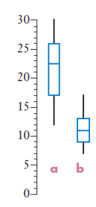
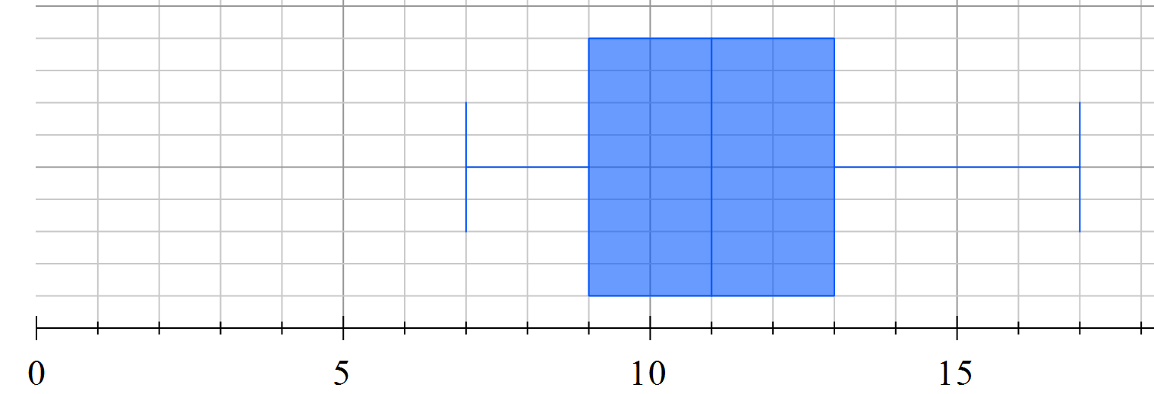
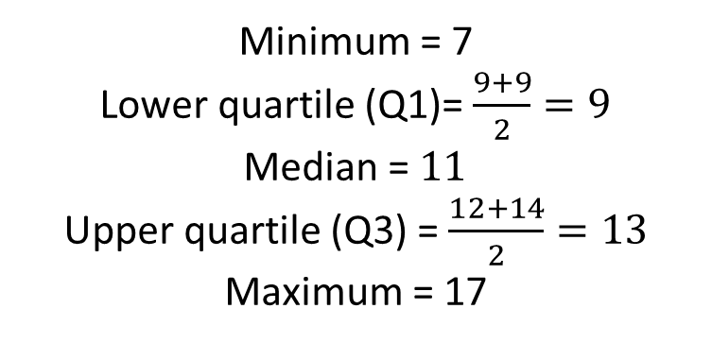
Drawing Boxplots
Note: Boxplots can also be drawn vertically.
Draw box and whisker plots for the sets of scores.
7 11 11 11 8 17 10 12 10 14 9 15 9
Step 1: Order the scores.
Step 2: Find the 5 number summary.
Step 3: Draw the boxplot.
7 8 9 9 10 10 11 11 11 12 14 15 17
Minimum = 7
Lower quartile (Q1)= $\frac{9+9}{2}=9$
Median = $11$
Upper quartile (Q3) = $\frac{12+14}{2}=13$
Maximum = 17
Lower quartile (Q1)
Median
(Q2)
Upper quartile
(Q3)

Slide 8
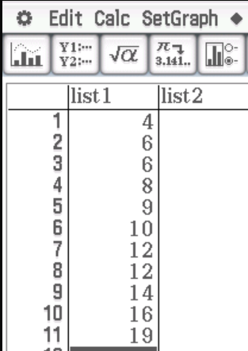
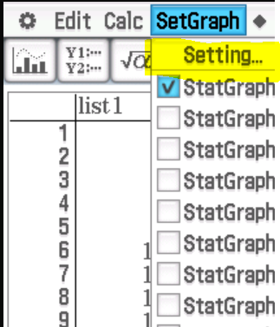
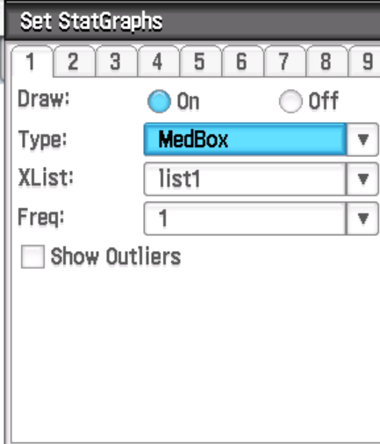
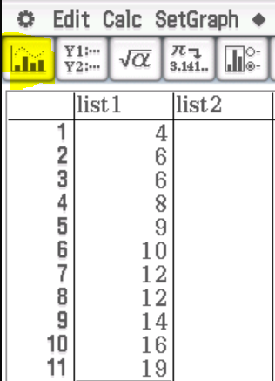
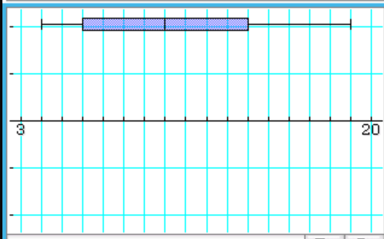
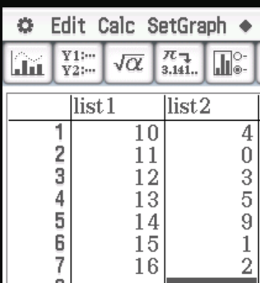
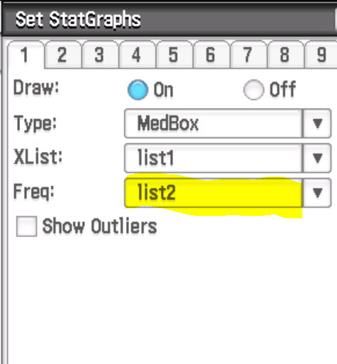
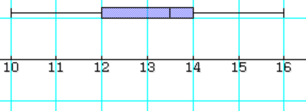
Drawing Boxplots on Class Pad
We can draw boxplots of a data set using our ClassPad.

Slide 9
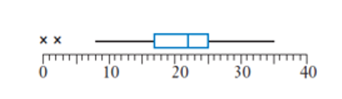
Boxplots and Outliers
Now do exercise 4A
If we want to, we can tick the box to ‘show outliers’ which allows us to view unusually high or low scores as separate points on the diagram.
If we choose to do this, the whiskers of our diagram are drawn to include all values which are within one and a half times the interquartile range away from Q1 or Q3.
For example, if the interquartile range is 8, the whiskers would only extend to scores that are no more than 12 (1.5x8) marks less than the lower quartile and no more than 12 marks higher than the upper quartile. Any scores beyond this are marked with an x.
The vast majority of questions will not ask you to do this, but you need to remember that values more than 1.5 x interquartile range beyond the lower and upper quartiles can be considered outliers if we choose to identify them.

